Slide 1
Hackathon 2025
Gen AI – Data Profiling Challenge
Team: DataXperts

Slide 2
Agenda
Hackathon Challenge
Schedule – H2 Report (use case)
Architecture
Gen AI Data Profiler
Interactive Compliance Assistant
Tech stack
Gen AI Data Profiler
Interactive Compliance Assistant
Gen AI Data Profiler Solutions
Rule Extracter
Anamoly Detecter/Risk scoring Solution
Results - Gen AI Data Profiler
Interactive Compliance Assistant
Conclusion
Team Details
Appendix

Slide 3
Hackathon Challenge
Development of a GEN AI data profiling solution that can:
Extract, interpret and refine regulatory reporting instructions to identify key data validation requirements.
Automatically generate profiling rules based on allowable values and cross-relation between the elements using a Large Language Model (LLM) or Machine Learning (ML). Few Line Items will need interpretation from multiple sources.
Generate executable validation code to assess whether the reported data conforms to extracted rules.
Suggest remediation actions for flagged transactions/observations, including automated explanations for auditors.

Slide 4
Schedule – H2 Reg reporting Instructions
H2 reg. report is for reporting the data of Commercial Real Estate (CRE) Schedule, which includes CRE loans and leases that are held for investment (HFI) and held for sale (HFS) as of report date.
Reporting Specifications:
Report all loan and lease financing receivables consistent with the FR Y-9C instructions.
Report the amortized cost for HFI loans and the lower of cost or fair value of HFS loans.
Report at fair value all HFS and HFI loans that the firm has elected to report under a fair value option.

Slide 5
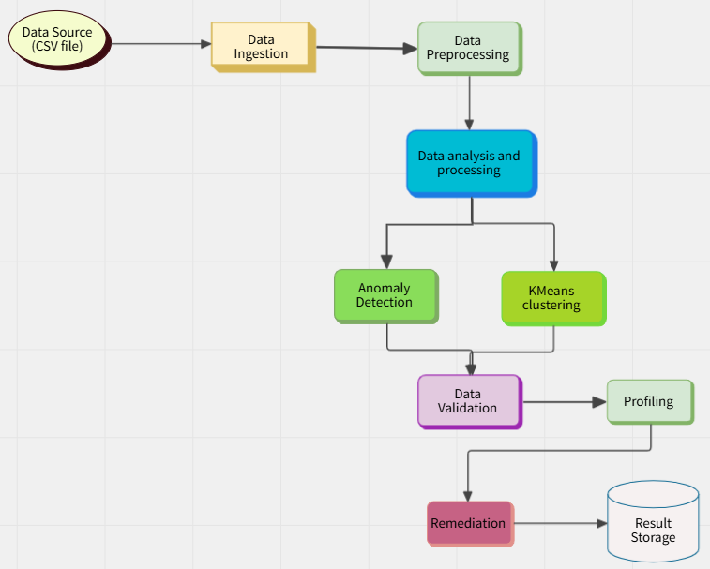
Architecture – Gen AI Data Profiler
Data Source:
CSV File: The data source, typically external (i.e., a file input), is represented at the start.
Processes:
Load CSV File: Reads the CSV file and loads it into a Pandas DataFrame. This is part of data ingestion.
Extract Preview Data: Prepares a preview of the dataset, typically the first 5 rows, for quick analysis.
Anomaly Detection (Isolation Forest): This is an ML-based process using Isolation Forest to detect anomalies in the dataset based on numerical data.
KMeans Clustering: Uses unsupervised machine learning to identify clusters of similar data points.
Dynamic Validation Rules: Automatically generated validation rules for the dataset columns based on the data types.
Profiling with LLM: Leverages OpenAI’s language model to generate data profiling rules, helping with regulatory compliance or quality checks.
Remediation Suggestions: Suggests steps to correct anomalies detected in the data (e.g., investigate irregular values or cross-check with source data).
Regulatory Interpretation: The query to the OpenAI model that helps interpret regulatory reporting requirements for the dataset.
Storage/Output:
Result Storage: After all processes are done, the results (anomalies, clusters, validation, remediation) are saved into an Excel file, providing output for further analysis.
Excel File: The results of the entire process are stored and can be easily exported or analyzed.

Slide 6
Architecture – Interactive Compliance Assistant

Slide 7
Architecture – Interactive Compliance Assistant (Contd.)
Streamlit UI: The user interacts with the UI. The primary components are:
File Uploader: User uploads an Excel file.
Profiling Rules: User defines, modifies, and deletes validation rules for columns in the dataset.
Validation Button: Triggers data validation by applying the defined rules.
AI-Powered Suggestions: User requests rule suggestions via OpenAI API.
Upload Excel File: The file is uploaded and processed by Pandas to create a DataFrame.
Data Preprocessing: The column names of the DataFrame are cleaned (lowercase, spaces replaced with underscores).
Profiling Rules:
Rules are added to st.session_state (which persists across interactions in the session).
Users can define custom rules for each column.
Validate Data:
The defined rules are applied to the dataset.
Flagged records (rows where validation fails) are stored and displayed.

Slide 8
Architecture – Interactive Compliance Assistant (Contd.)
Flagged Records: The flagged rows are displayed to the user, showing where data does not meet the defined profiling rules.
OpenAI API for Rule Suggestions:
The user can input an OpenAI API key.
A query is sent to OpenAI's GPT to suggest rules for the dataset's columns.
The AI response (rules) is displayed in the UI.
Results Display:
Flagged records and AI rule suggestions are shown to the user.

Slide 9
Tech Stack – Gen AI Data Profiler
Creating a data profiling tool in Python involves integrating multiple libraries to analyze data and generate insights automatically.
The process typically involves importing the dataset, applying libraries to assess data types, distribution, and quality metrics, and generating visualizations to present findings effectively.
Scikit-learn: For machine learning models (Isolation Forest for anomaly detection, KMeans for clustering).
Python Libraries for Data Profiling
Pandas: offers data manipulation capabilities, and Pandas Profiling, which generates comprehensive reports from DataFrames.
Open AI: provides convenient access to the OpenAI REST API from any Python 3.8+ application. The library includes type definitions for all request params, and response fields and offers both synchronous and asynchronous clients. Our solution uses this apckage to create profiling rules using LLM and ML.
JSON: used to work with JSON data by converting the strings. Our solution used this package to convert the input file data to JSON format that contain the validation rule to apply on each column level.

Slide 10
Tech Stack – Interactive Compliance Assistant
Component | Technology Used
Frontend UI | Streamlit
Backend Processing | Python (Pandas, OpenAI API)
Data Storage | In-memory storage (Streamlit session state)
AI Integration | OpenAI GPT-4o for compliance rule generation
Validation Engine | Python eval() for rule validation
File Handling | Pandas (Excel processing)

Slide 11
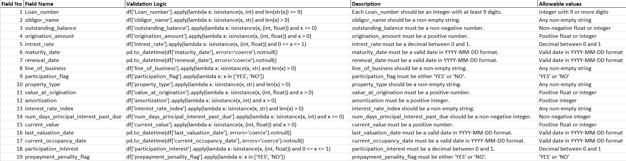
Gen AI Data Profiler Solutions – Rule Extractor
Solution uses OPENAI for generating and extracting the rules as per the regulatory requirements. These are then used for profiling the data as required.
Rules generated using the code:

Slide 12
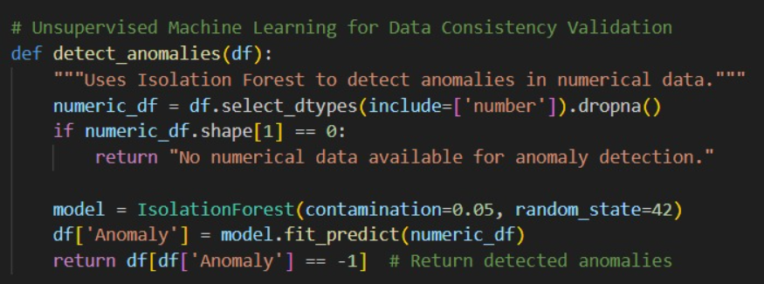
Gen AI Data Profiler Solutions – Anamoly Detecter
Once the rules are extracted, those are imposed on the input data to identify the anomalies in it.
Below code is used for the same:

Slide 13
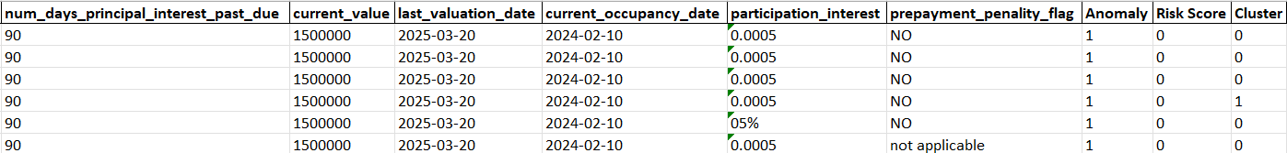
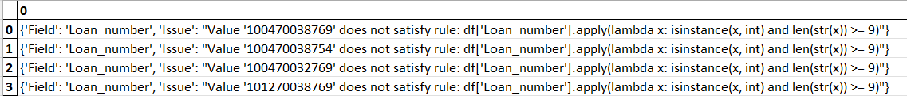
Results - Gen AI Data Profiler
An excel sheet is created with all the rule sets extracted, anomalies detected, Validation done, Rik Scores and the Remediations for the input file provided to code as the result in an excel sheet. Using this, profiling issues could be remediated.
Anomalies Sample:
Cluster Sample:
Validations Sample:

Slide 14
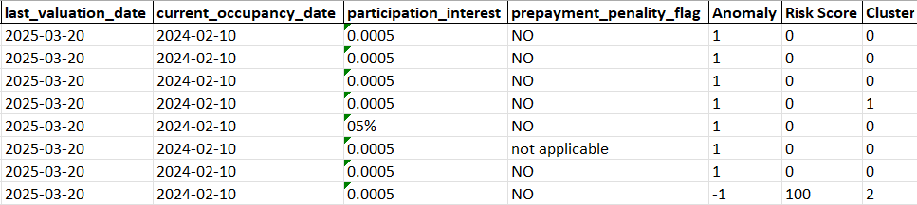
Results - Gen AI Data Profiler (Contd.)
Remediation Sample:
Risk Score Sample:

Slide 15
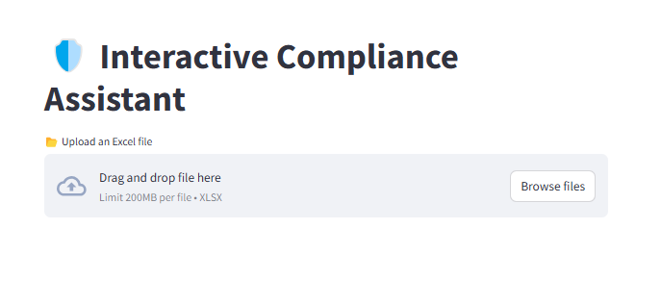
Interactive Compliance Assistant
Interactive Compliance Assistant is UI enabling auditors to Add/Modify the profiling rule sets.
Upload the input Excel file data.

Slide 16
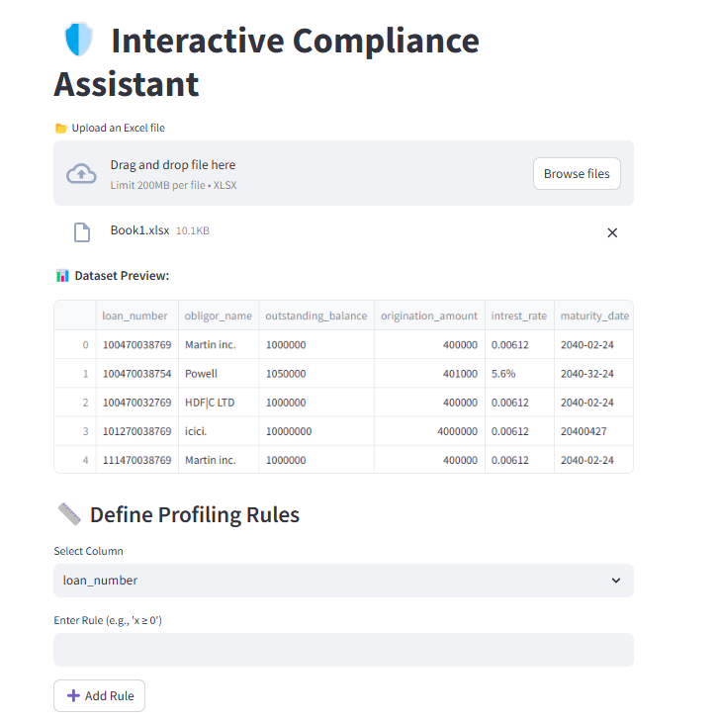
Interactive Compliance Assistant (Contd.)
Data set preview and profiling rules

Slide 17
Conclusion
Using this Gen AI Data Profiling solution with Python would provide below:
Efficient Data Insights
Leveraging Gen AI & Python for automated, scalable data profiling
Faster and more accurate discovery of data quality issues
Actionable Data Quality Metrics
Data completeness, consistency, uniqueness, and distribution metrics
Continuous profiling for dynamic data sets
Cost & Time Efficiency
Reducing manual intervention and accelerating data preparation processes
Easy integration with existing workflows and systems

Slide 18





Team Details - DataXperts
Shyam S. Vuppala (Team Captain)
Mahendra Kante Joyeta Dhar Praveen Kumar Kaasireddy Sai Ganesh Somisetty

Slide 19
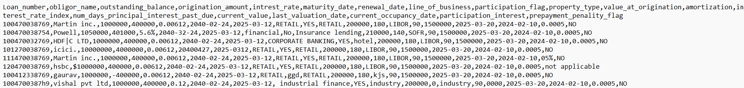
Appendix
Public GIT HUB link: DataXperts
H2 Regulatory Report link: Regulatory Report format
Sample CSV:

Slide 20
Thank you

